Slide 2
OUTLINE
Introduction
Block diagram
Working
Result discussion
Advantages
Disadvantages
Conclusion
Future scope
References

Slide 3
INTRODUCTION
The implementation of surveillance systems within wildlife sanctuaries can become a pivotal tool in modern conservation practices. This system offers a means to monitor and track wildlife and deter poaching activities. Another issue is that we can’t implement any electronics device to any wildlife animal as it can be illegal as well as it can’t be practically possible.
This project combines the technologies like ultrasonic sensing device, laser detector with IoT implementation. We are implementing two security surveillance zones with strategically placed of camera at the boundary areas.

Slide 4
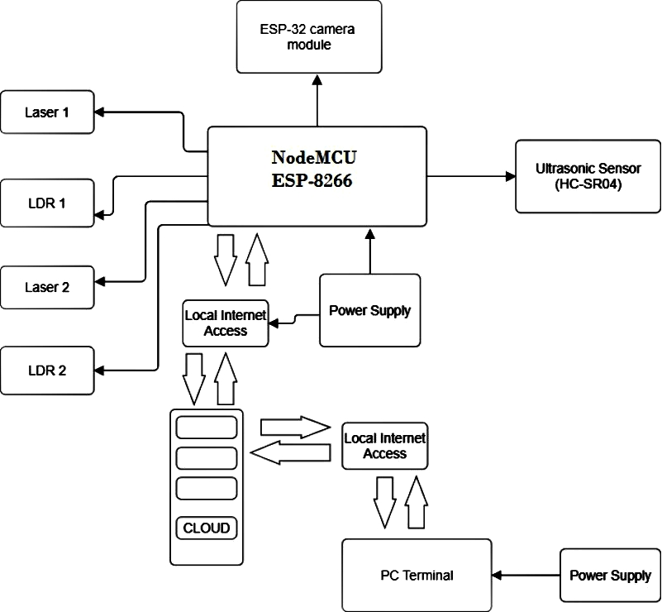
BLOCK DIAGRAM
Fig.1 Block diagram of Smart surveillance system for wildlife

Slide 5
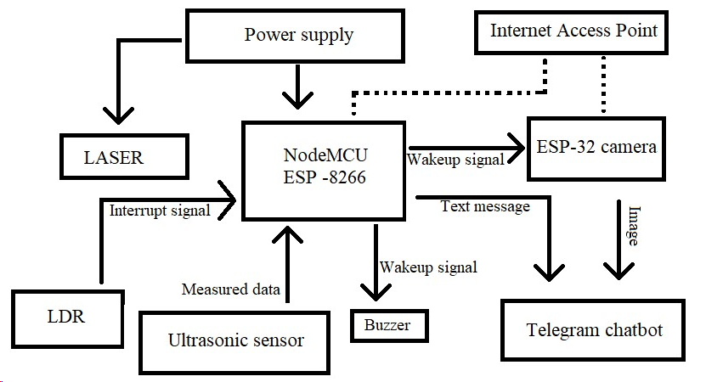
WORKING
Fig.2 Working flow chart of Smart surveillance system for wildlife

Slide 6
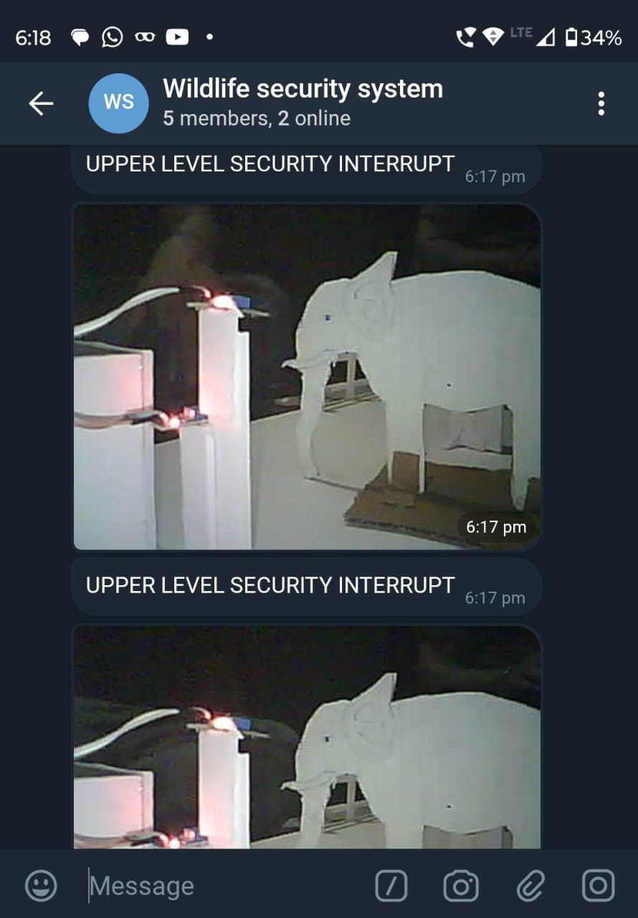
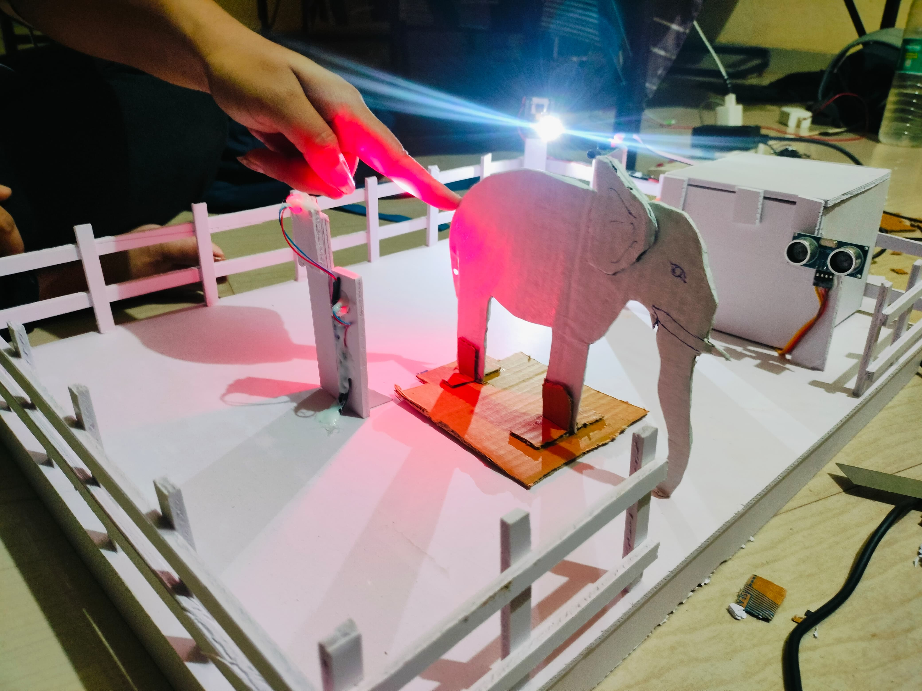
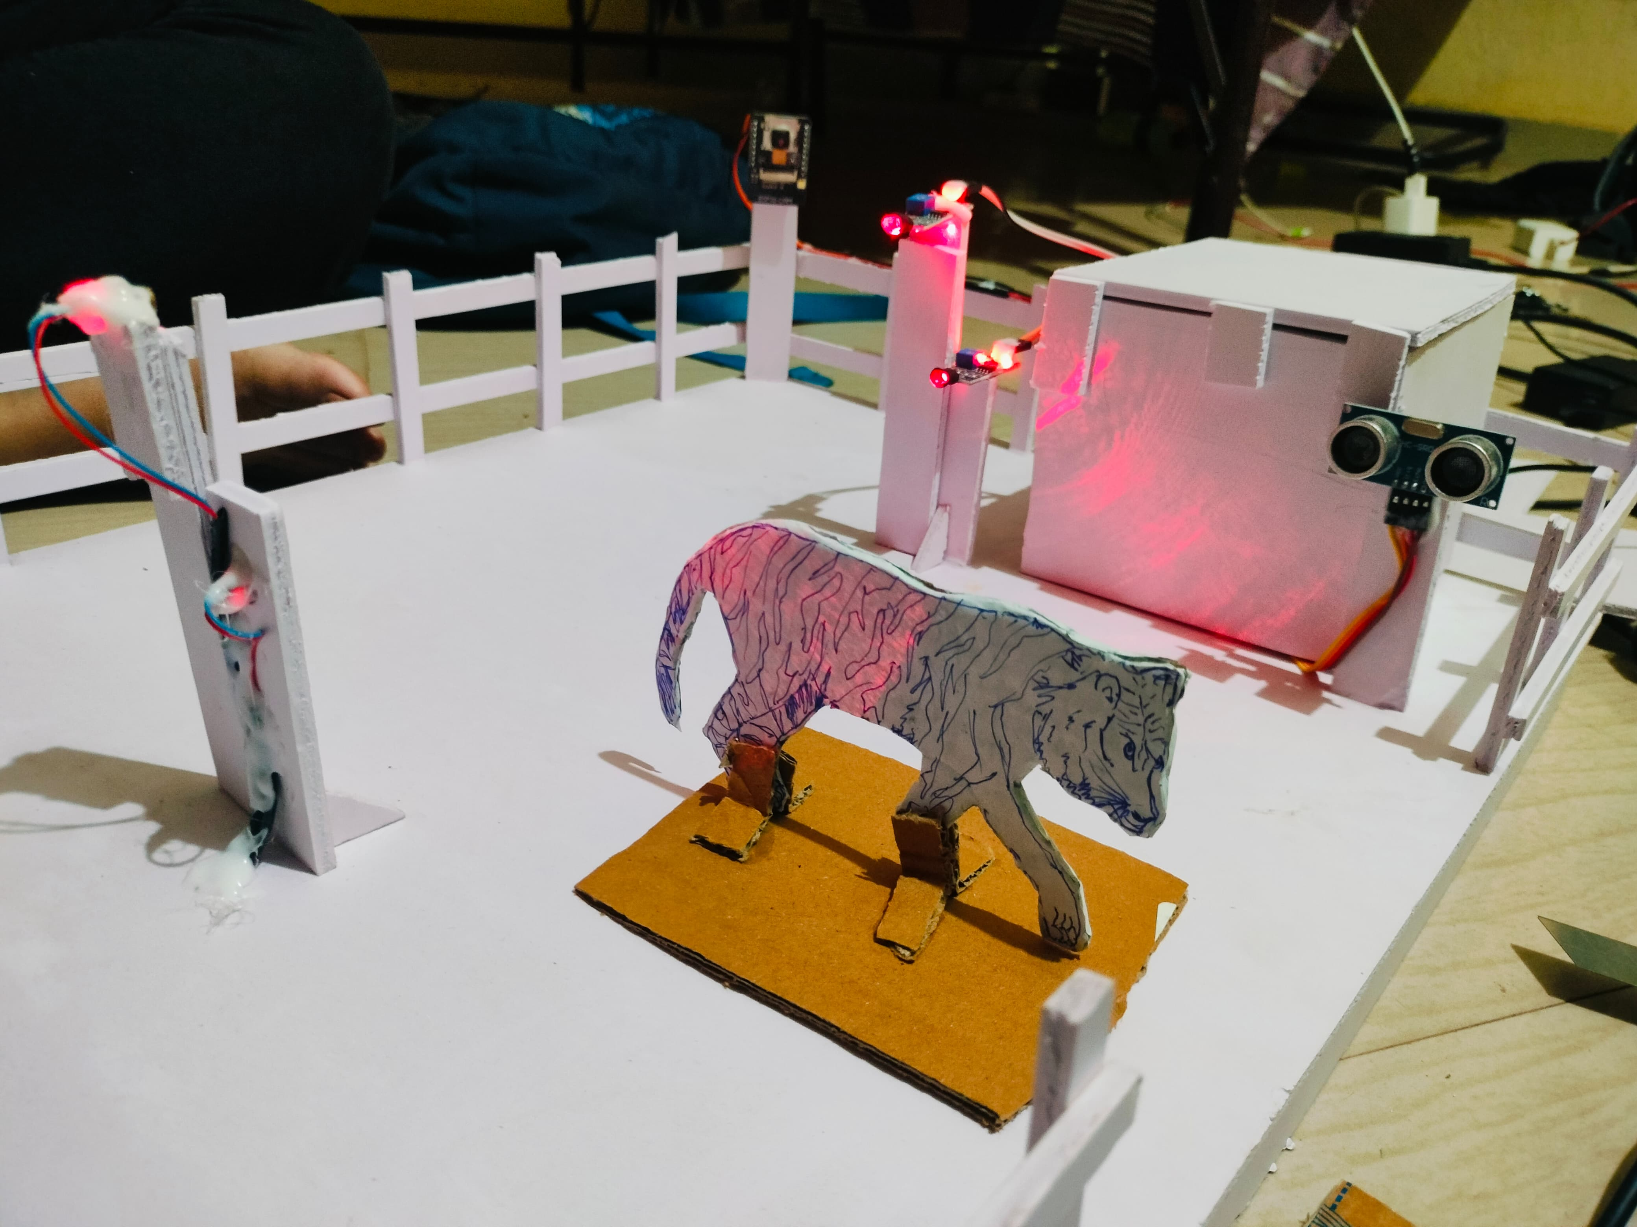
RESULT DISCUSSION
Real time image capturing.
LDR detect interruptions.
The ultrasonic sensor notifies when animal detects under its range.
Fig.3 Animal escapes from the sanctuary
Fig.4 Telegram chat bot

Slide 7
ADVANTAGES
Real time image.
Reduce manpower.
Reduce time to time patrolling.
Remote access from multiple devices.
High alerting system.
DISADVANTAGES
Initial installation cost can be high.
24/7 power supply and internet supply.

Slide 8
CONCLUSION
The integration of IoT, embedded systems, and sensor technology in the Smart surveillance system for wildlife project has led to the development of a robust and efficient monitoring system. By utilizing a combination of hardware components such as NodeMCU (ESP8266), ESP-32 camera, laser diodes, photoresistors, ultrasonic distance sensors (HC-SR04), and a buzzer, coupled with software tools like Arduino IDE and a Telegram chat-bot, a comprehensive surveillance network has been established.

Slide 9
FUTURE SCOPE
Integrating artificial intelligence (AI) and machine learning algorithms into the surveillance.
Integrating drone and aerial surveillance.
Utilizing satellite imaging and remote sensing technologies.
Implementing solar technology.

Slide 10
REFERENCES
Extinction risk assessments, such as the International Union for Conservation of Nature (IUCN) Red List, provide valuable insights into the status of species and prioritize conservation efforts (IUCN, 2020).
Conflict between humans and wildlife, particularly in areas where human activities overlap with natural habitats, poses significant challenges to conservation efforts (Dickman, 2010).
IoT Analytics: Strategy and Implementation" by Jesus Rogel-Salazar - This book delves into IoT analytics, covering techniques for collecting, processing, and analyzing data generated by IoT devices to derive actionable insights.
"Designing Connected Products: UX for the Consumer Internet of Things" by Claire Rowland, Elizabeth Goodman, Martin Charlier, and Ann Light - This book focuses on the user experience (UX) design principles for IoT products, offering insights into designing successful connected products.
Exploring Arduino: Tools and Techniques for Engineering Wizardry" by Jeremy Blum - This book offers a comprehensive guide to Arduino programming and projects, covering topics such as programming basics, interfacing with sensors and actuators, and building real-world applications.
Telegram Bot API Documentation: The official Telegram Bot API documentation (https://core.telegram.org/bots/api) provides detailed information about the API methods, parameters, and usage examples for building Telegram bots in various programming languages.
Getting Started with Arduino" by Massimo Banzi - While not solely focused on buzzers, this book covers the basics of Arduino programming and electronics, including how to use buzzers as output devices in various projects.

